Slide 1

Before You Start
How to Install R/R Studio
How to install JAVA(JRE) from Oracle
How to install Morpheme Analyzer and how to run it in R

Slide 2
1. Download R and R studio (Mac Users)
To Install R:
Open an internet browser and go to www.r-project.org.
Click the "download R" link in the middle of the page under "Getting Started."
Select a CRAN location (a mirror site) and click the corresponding link.
Click on the "Download R for (Mac) OS X" link at the top of the page.
Click on the file containing the latest version of R under "Files."
Save the .pkg file, double-click it to open, and follow the installation instructions.
Now that R is installed, you need to download and install RStudio
To Install R Studio:
Go to www.rstudio.com and click on the "Download RStudio" button.
Click on "Download RStudio Desktop."
Click on the version recommended for your system, or the latest Mac version, save the .dmg file on your computer, double-click it to open, and then drag and drop it to your applications folder

Slide 3
1. Download R and R studio (Windows Users)
To Install R:
Open an internet browser and go to www.r-project.org.
Click the "download R" link in the middle of the page under "Getting Started."
Select a CRAN location (a mirror site) and click the corresponding link.
Click on the "Download R for Windows" link at the top of the page.
Click on the "install R for the first time" link at the top of the page.
Click "Download R for Windows" and save the executable file somewhere on your computer. Run the .exe file and follow the installation instructions.
Now that R is installed, you need to download and install RStudio
To Install R Studio:
Go to www.rstudio.com and click on the "Download RStudio" button.
Click on "Download RStudio Desktop."
Click on the version recommended for your system, or the latest Windows version, and save the executable file. Run the .exe file and follow the installation instructions.

Slide 4
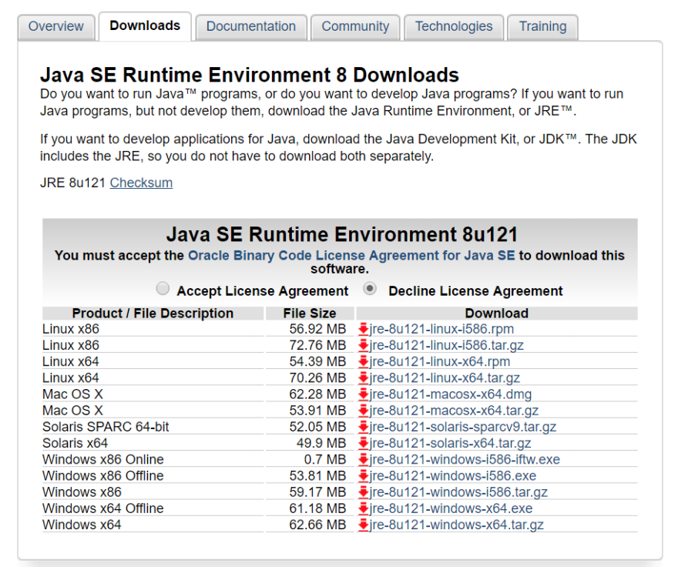
2. Download JRE 1.8 ( for Windows Users Only)
Go to the following website: http://www.oracle.com/technetwork/java/javase/downloads/jre8-downloads-2133155.html
Download JRE based on your operating system
Run the exe file

Slide 5
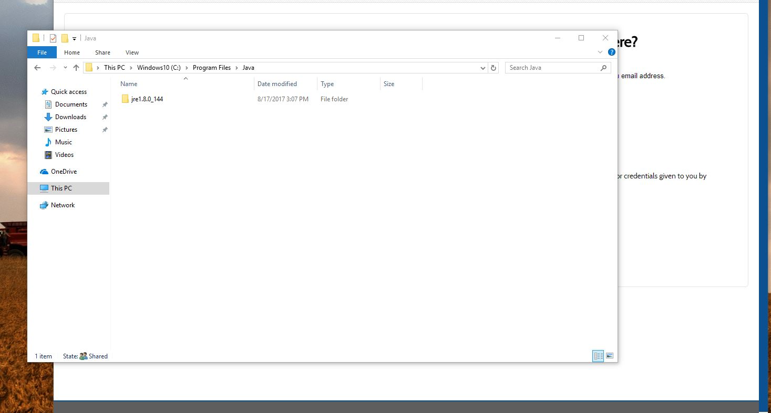
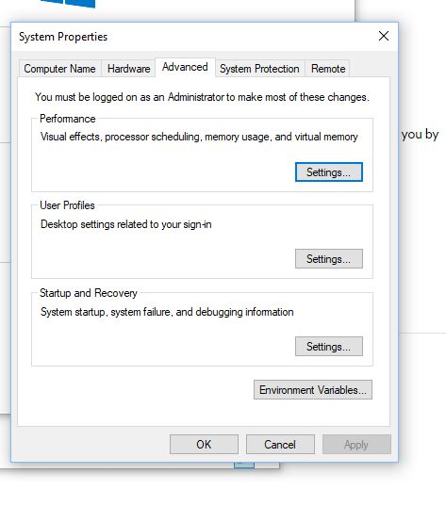
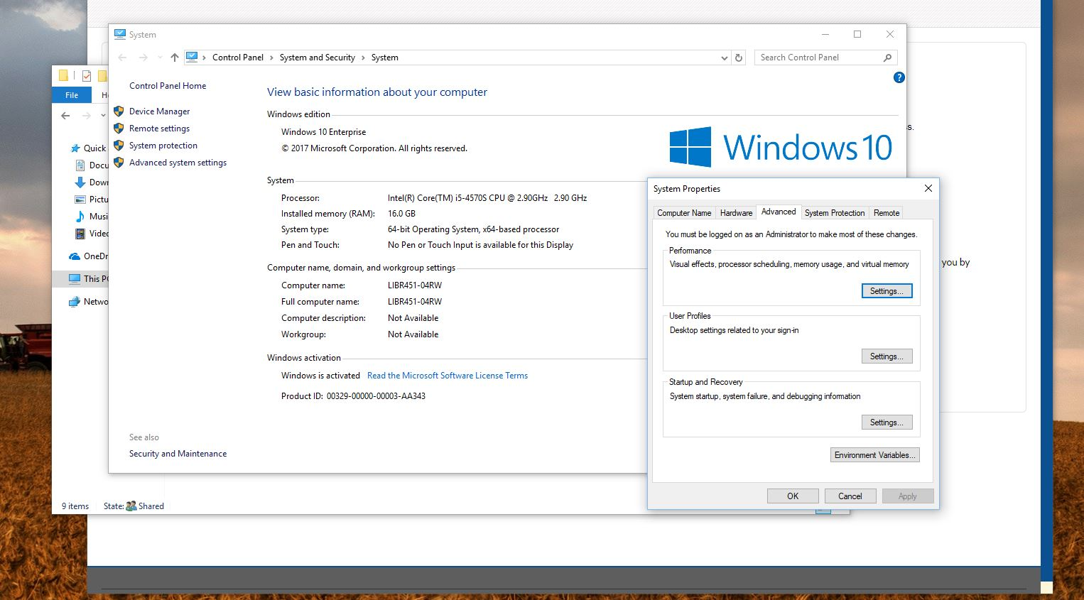
Make sure you have your JRE downloaded in your Program Files folder
Go to System menu and go to Advanced system settings
Go to Environment Variables

Slide 6
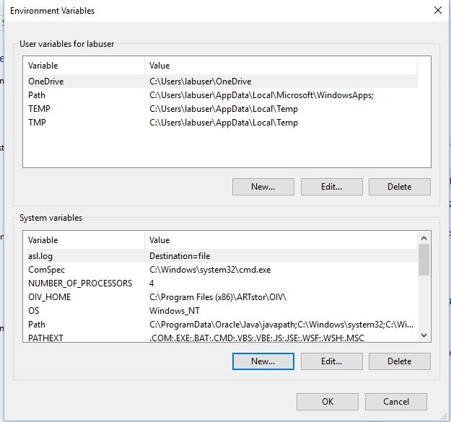
Under the System Variables, click “New…”

Slide 7
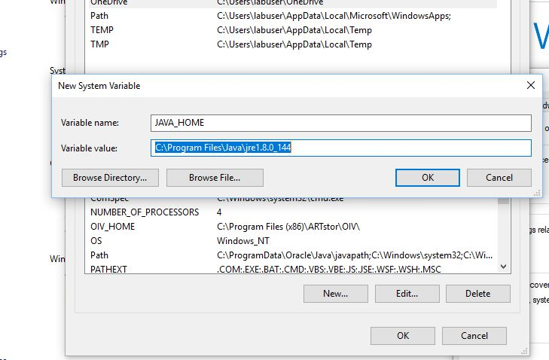
Variable name should be JAVA_HOME and click Browse Directory so your variable value is showing the directory to your newly installed JRE folder as the picture on the left.

Slide 8
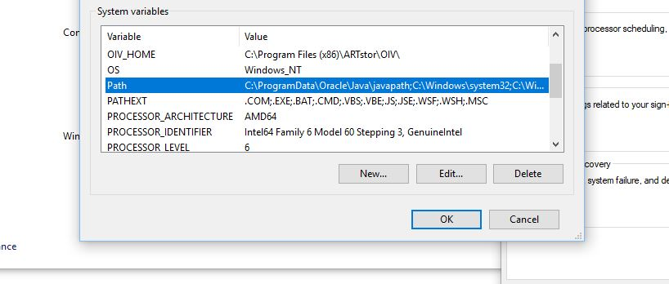
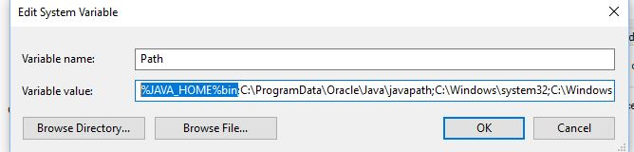
Setting path variable – double click the Path variable that will lead you to the picture on the lower left
Either add ;%JAVA_HOME\bin% at the very last of the path variable value or add %JAVA_HOME\bin%; at the very front like the picture on the left
Hit OK once you are done

Slide 9
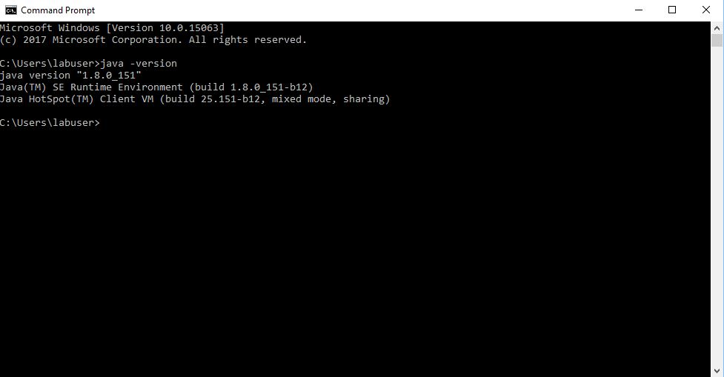
Launch ”CMD” , or Command Prompt, from the start menu in windows and type java -version as the above to make sure our Java version is printed

Slide 10
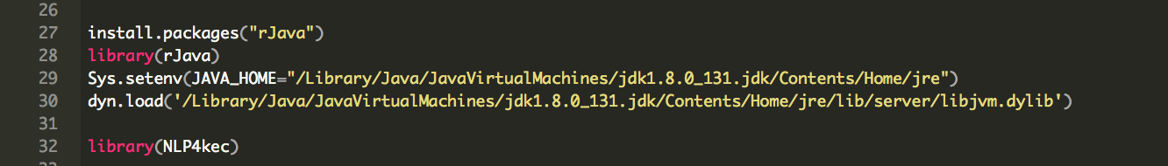
2. Download JRE 1.8 (for Mac Users Only)
Launch Terminal and type the following command: vi ~/.profile
Under the vi editor, set your JAVA_HOME by typing this: export JAVA_HOME = /Library/Java/JavaVirtualMachines/jre1.8.0_131.jre/Contents/Home
Save the information and register your command by typing this: source ~/.profile
End Terminal and re-launch Terminal to see everything is installed by typing this: /usr/libexec/JAVA_HOME –V
If this doesn’t work, no worries!
Forget about the above and just follow through the script. The R scripts that are provided have commands that can solve these issues like the picture below.
Just make sure the directory to your JAVA/JRE is correctly stated.

Slide 11
3. Download the package “NLP4kec.zip”
Download the package “NLP4kec.zip” into your R studio project working directory and simply expand the zip file

